Slide 1
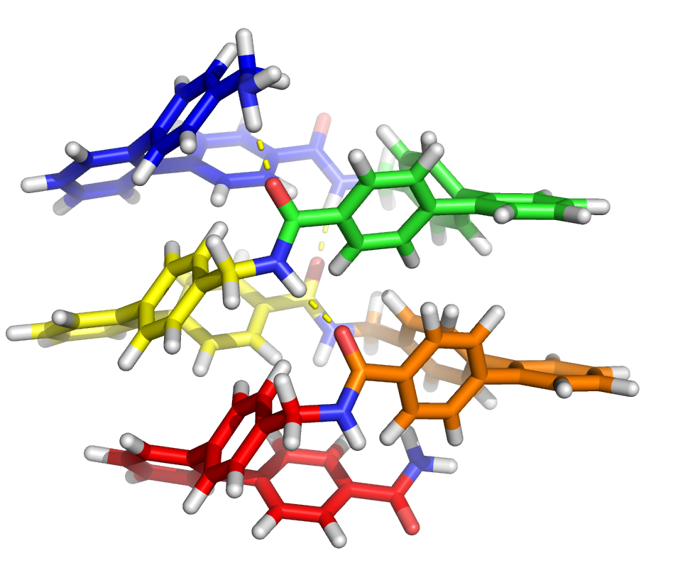
terphenyl amino acids: a new foldamer scaffold?
imaginary helical oligomer structure
Terphenyl₅
MMF94 minimized
FAKE
m- or o-terphenyl may be utilized
standard amino acids can be interspersed in oligomer sequence

Slide 2
progress
monomer
multiple grams
purified
found mass
dimer
~1.5 grams
purified
found mass
tetramer
~50 mg
maybe purified?
found mass, messy NMR
octamer
a dream

Slide 3
Heterogeneous backbones: interspersing α-amino acids
Aib
L- vs D- alpha amino acids?

Slide 4
Many Subunit Possibilities!

